Slide 1
Hands-on session “users”
Introduction

Slide 2
Outline
The purpose of this session is to give a “hands-on” experience of using pysteps
The session is divided into 5 exercise blocks + bonus exercises
In the following slides, we give an introduction to the basic pysteps workflow

Slide 3
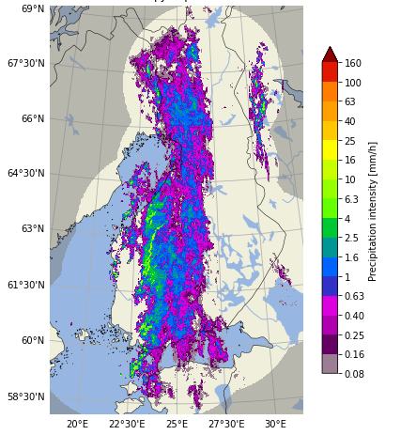
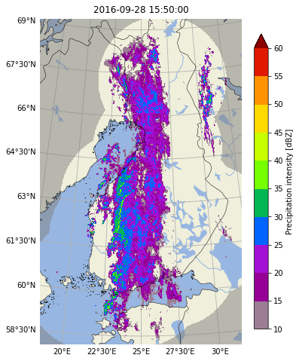
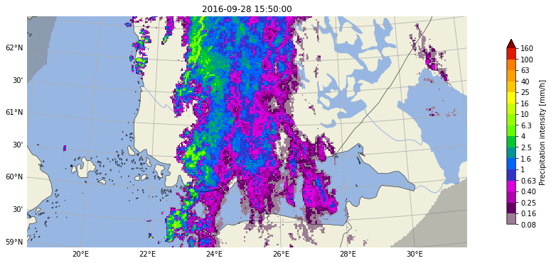
Input data
Transformations and conversions between units
pysteps uses radar composites as the main input data source
Reading input data from various sources has been implemented in the io.importers module
To implement your own importers, you can use cookiecutter: https://pysteps.readthedocs.io/en/stable/developer_guide/importer_plugins.html
The utils module contains different methods for transforming, clipping and upsampling the input data
Clipping

Slide 4
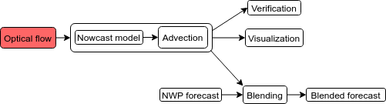
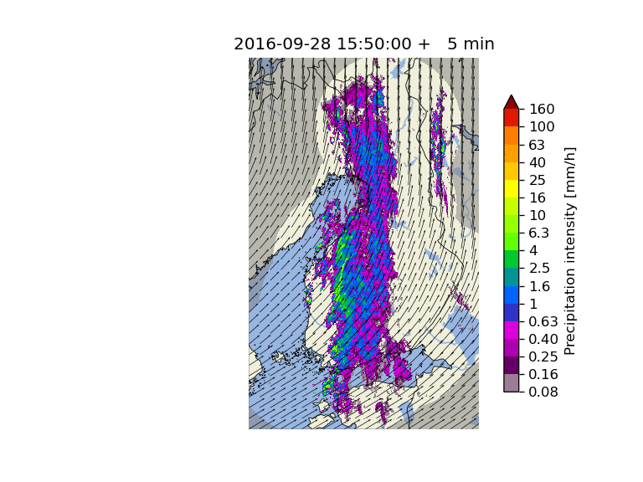
Optical Flow and Extrapolation
Advection (optical flow & extrapolation) is the key component of all pysteps nowcasting methods
All methods are based on the “Lagrangian persistence” nowcast shown on the right
Three different types of optical flow methods have been implemented in the motion module:
feature tracking: Lucas-Kanade
variational: VET and Proesmans
spectral: DARTS
For advection, pysteps implements the backward semi-Lagrangian scheme in the extrapolation module

Slide 5
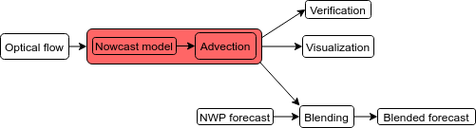
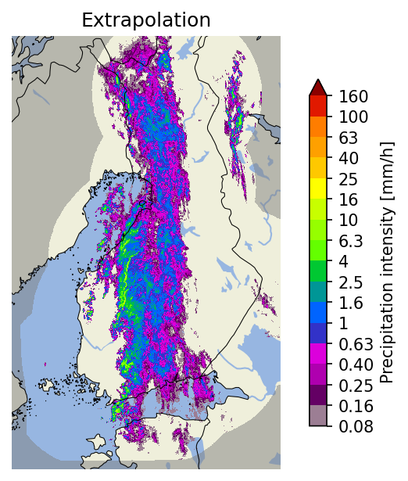
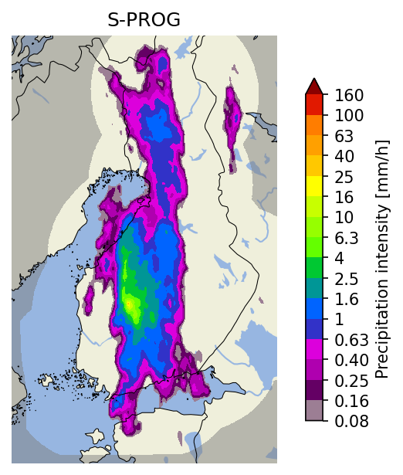
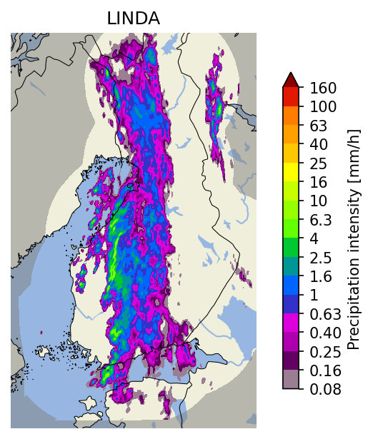
Deterministic Nowcasts
The main methods implemented in the nowcasts module:
Method | Pros | Cons | Typical computation time
Extrapolation | very fast | no prediction of growth or decay of precipitation | < 10 seconds
S-PROG | for low-intensity precipitation (< 1-2 mm/h) has generally the best skill choose for stratiform events | inability to preserve the spatial structure of rainfall fields, and particularly convective cells | < 20 seconds
LINDA-D | the most accurate method for intense precipitation (> 1-2 mm/h) choose for convective events | slow to compute | might take several minutes

Slide 6
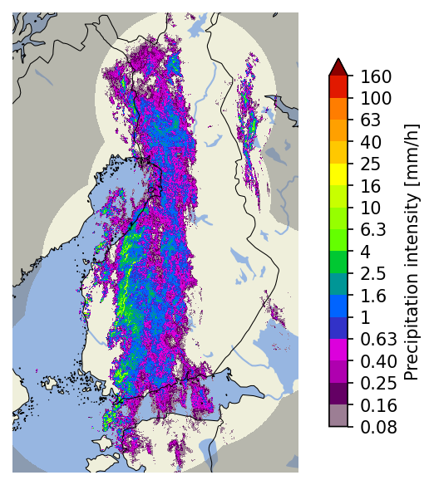
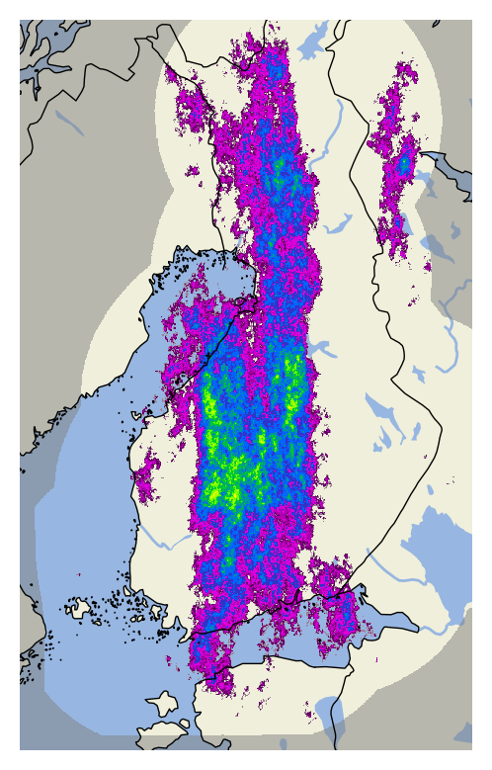
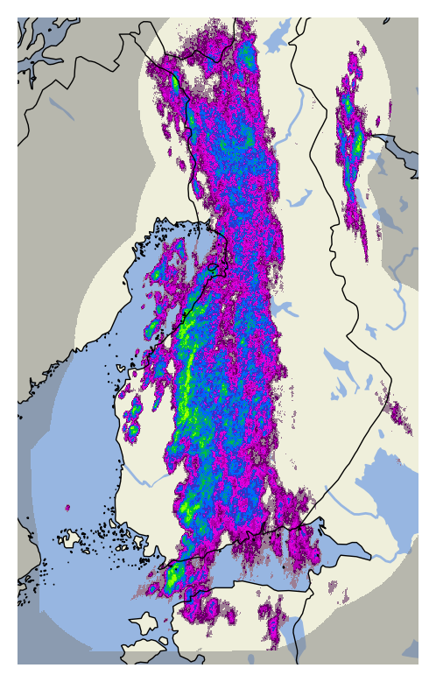
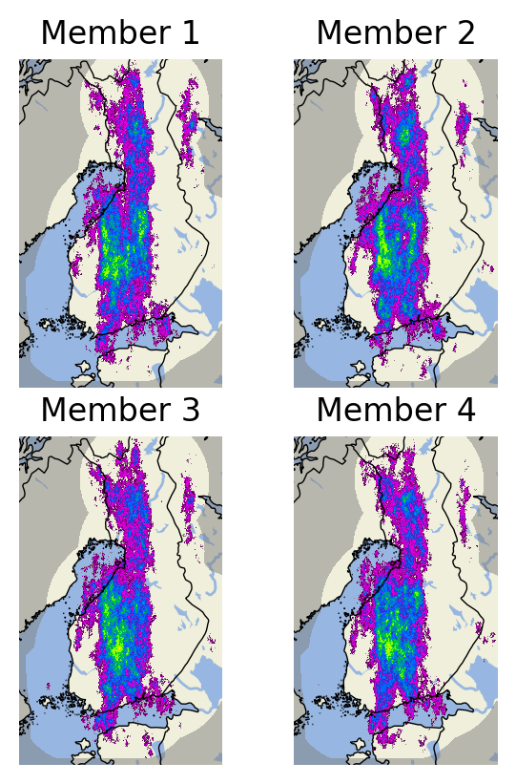
Ensemble Nowcasts
Observations at 2016-09-28 15:50 UTC
First ensemble members
STEPS
LINDA-P
The main ensemble methods implemented in the nowcasts module are STEPS and LINDA-P
They model two sources of uncertainty: advection field estimation and Lagrangian growth and decay
The basic rule for choosing the method:
stratiform events: STEPS
convective events: LINDA-P
LINDA-P generally produces more realistic ensemble members
Computation times for the 4-member ensembles shown on the right:
STEPS: ~20 seconds
LINDA-P: ~5 minutes
Nowcast ensemble

Slide 7
Benchmarking other methods
From the documentation:
When selecting correct method to benchmark against e.g. machine learning models, consider what do you want to achieve with the model
preserve variance
minimize error
represent uncertainty?
To get comparable forecasts, use methods that try to achieve similar objectives
For a more detailed discussion, see the documentation
Nowcast type | Machine learning | pysteps | Verification
Deterministic (variance-preserving) | SRGAN, Others? | pysteps.nowcasts.extrapolation (any optical flow method) | MSE, RMSE, MAE, ETS, etc
Deterministic (error-minimization) | Classical ANNs, (deep) CNNs, random forests, AdaBoost, etc | pysteps.nowcasts.sprog, pysteps.nowcasts.anvil or ensemble mean of pysteps.nowcasts.steps/linda | MSE, RMSE, MAE, ETS, etc or better normalized scores, etc
Probabilistic (quantile-based) | Quantile ANN, quantile random forests, quantile regression | pysteps.nowcasts.lagrangian_probability or probabilities derived from pysteps.nowcasts.steps/linda | Reliability diagram (predicted vs observed quantile), probability integral transform (PIT) histogram
Probabilistic (ensemble-based) | GANs, VAEs, etc | Ensemble and probabilities derived from pysteps.nowcasts.steps/linda | Probabilistic verification: reliability diagrams, continuous ranked probability scores (CRPS), etc. Ensemble verification: rank histograms, spread-error relationships, etc

Slide 8
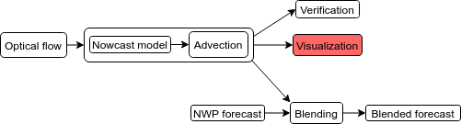
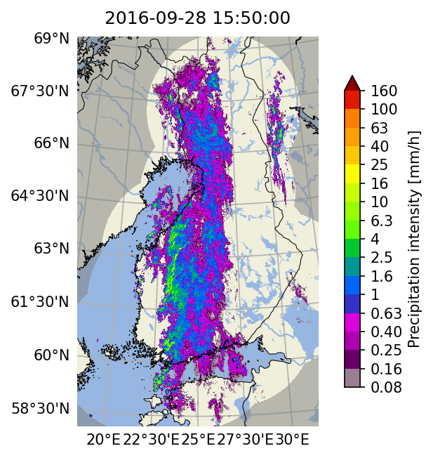
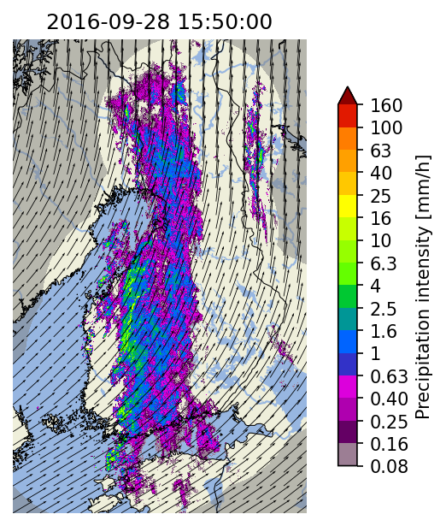
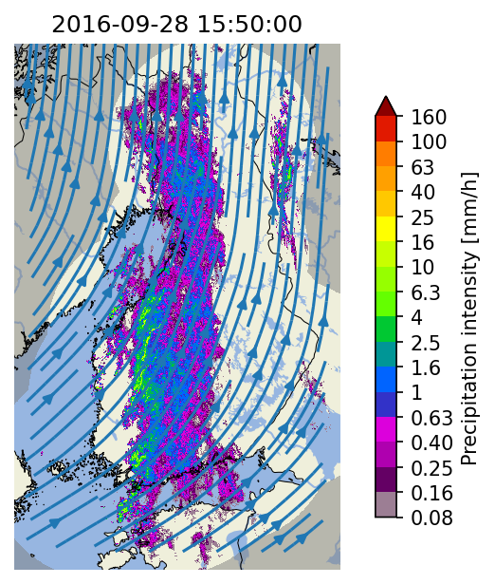
Visualization tools
Colorbars with several pre-configured scales and for different data units
Longitude-latitude lines with labels
Extensive set of visualization tools has been implemented in the visualization module
Support for multiple layers: basemap, precipitation and motion field:
plotting of basemaps by using cartopy
quivers and streamlines for advection fields

Slide 9
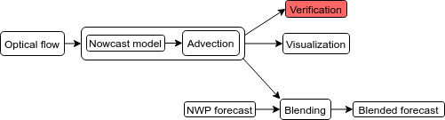
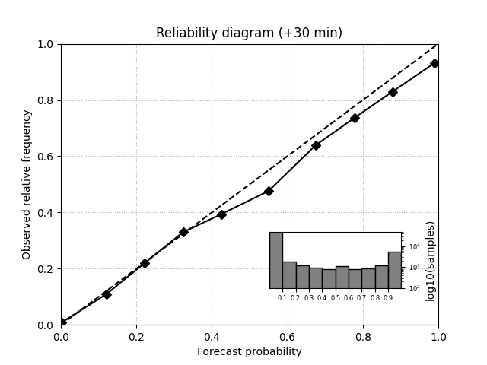
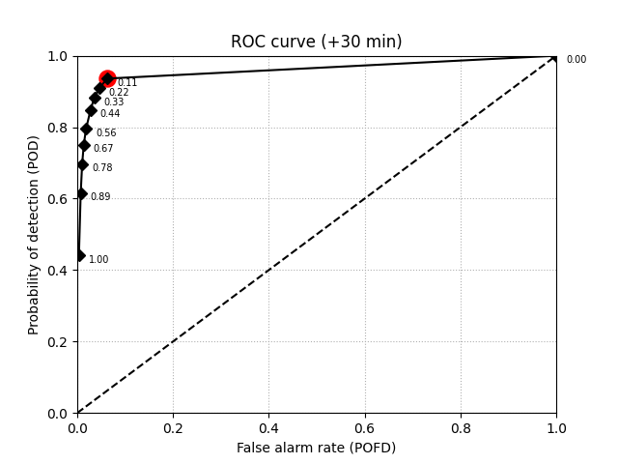
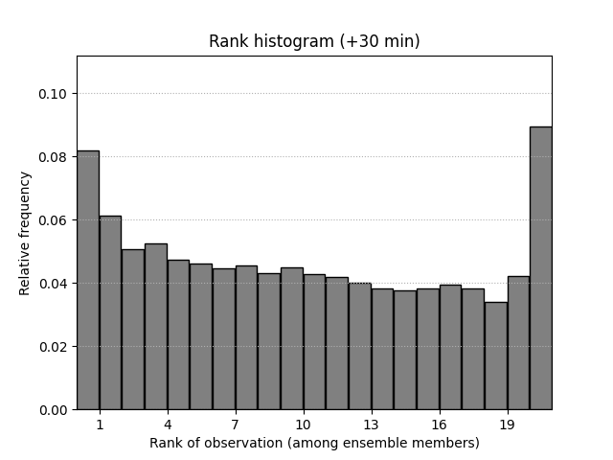
Verification tools & metrics
Examples of verification plots for
30-minute STEPS nowcasts
Metrics
A large number of verification utilities and metrics have been implemented in the verification module
Functionality
creation of verification objects and aggregation from multiple nowcasts
plotting of verification results
Deterministic
categorical: CSI, ETS, POD, FAR
continuous: MAE, ME
scale/intensity-based metrics: FSS, intensity-scale
radially averaged power spectral density (RAPSD)
Probabilistic
CRPS
reliability diagram
Ensemble
spread
rank histogram

Slide 10
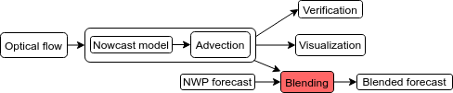
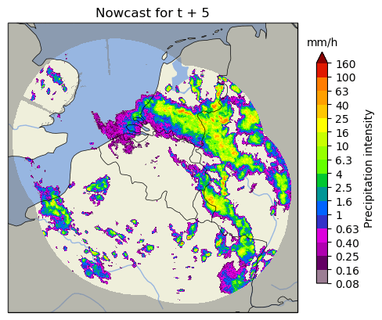
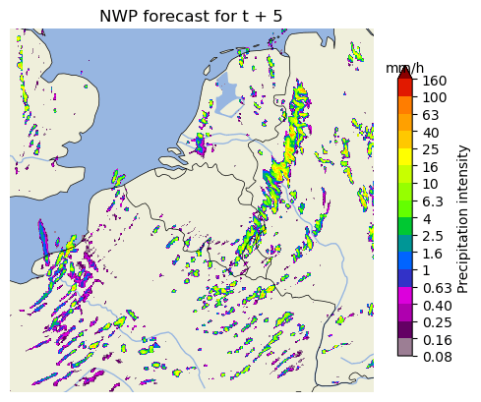
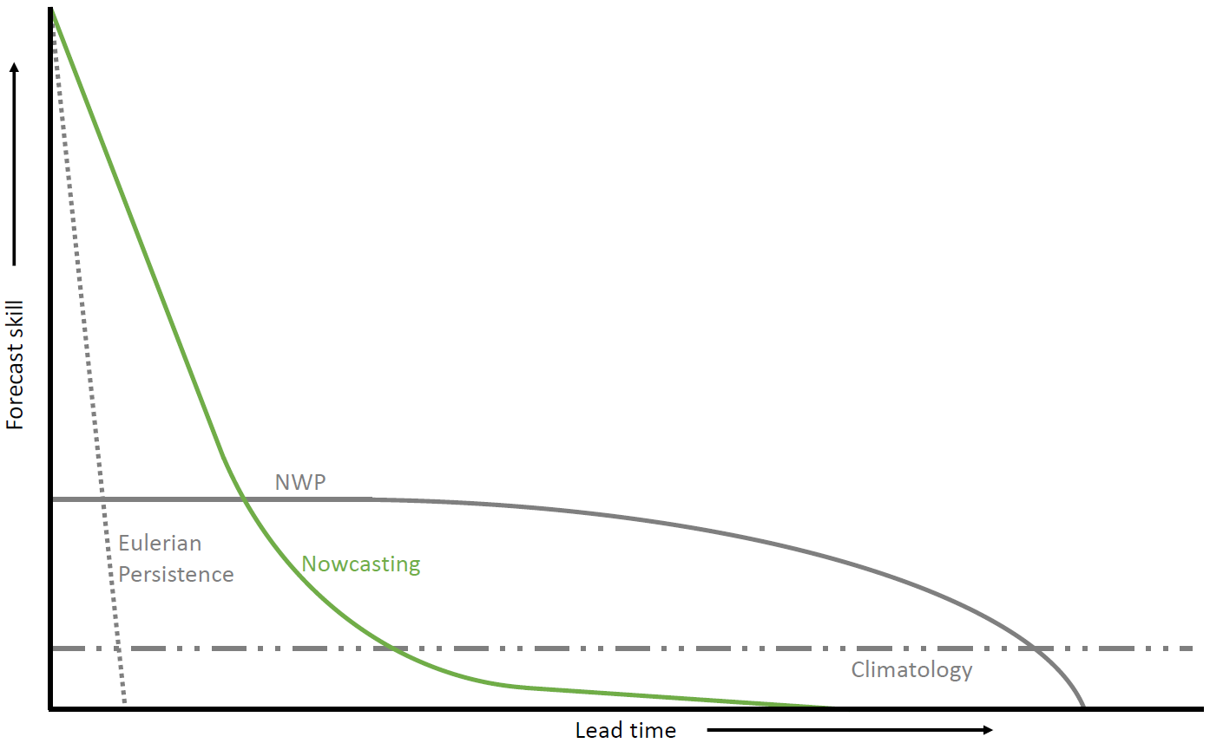
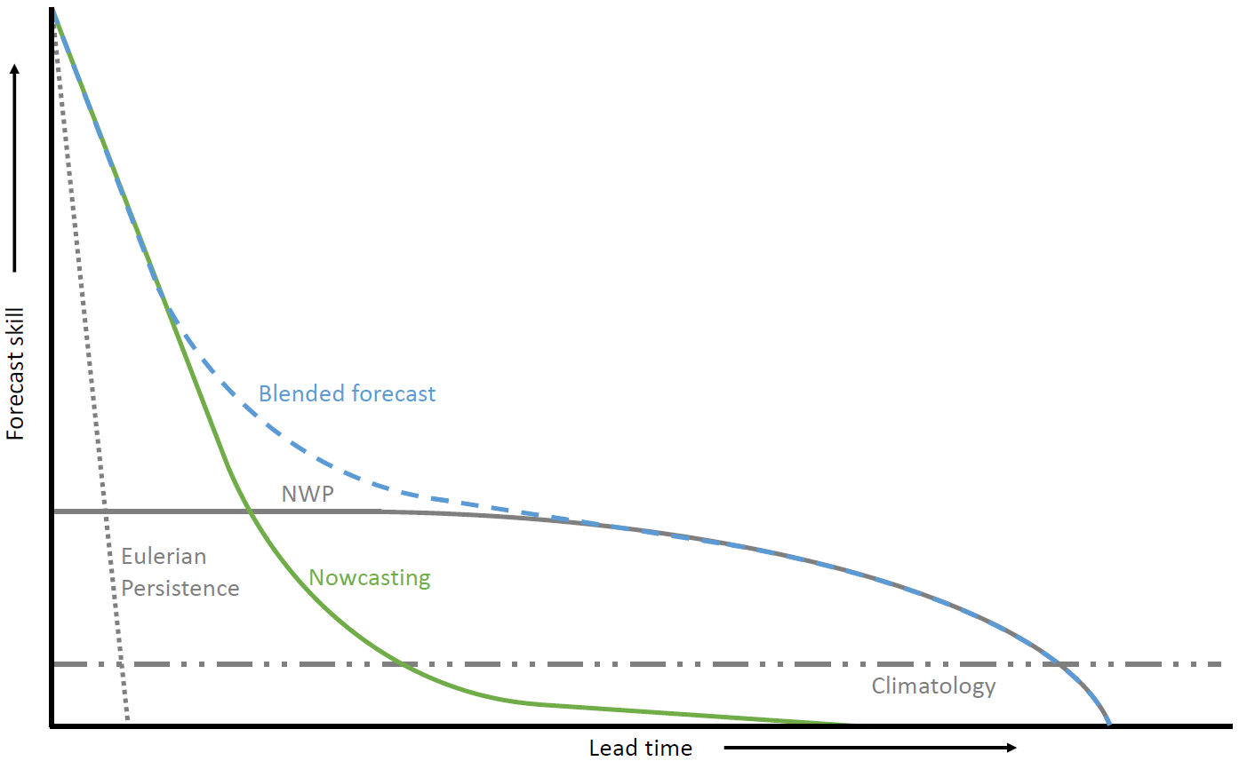
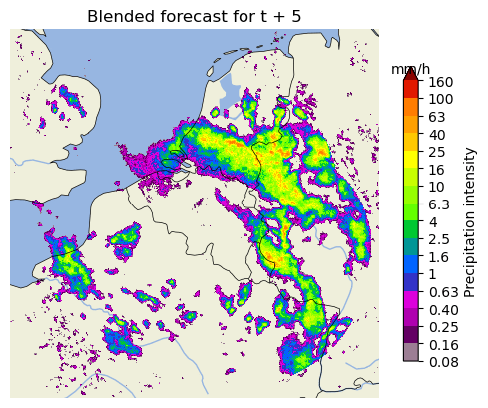
Blending with NWP
Nowcasting more skillful than NWP up to approx. 2 h. Often not enough for (flood) early warning.
How to improve the rainfall forecast up to 6 h or more ahead?

Slide 11
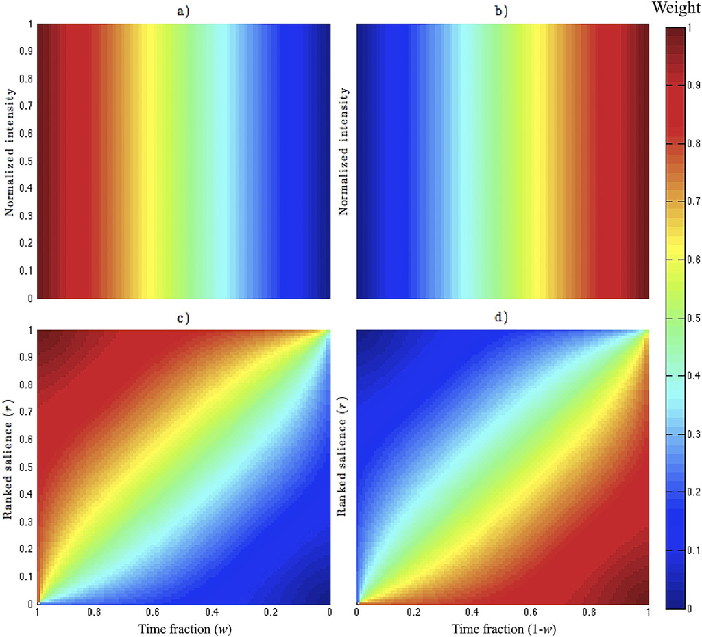
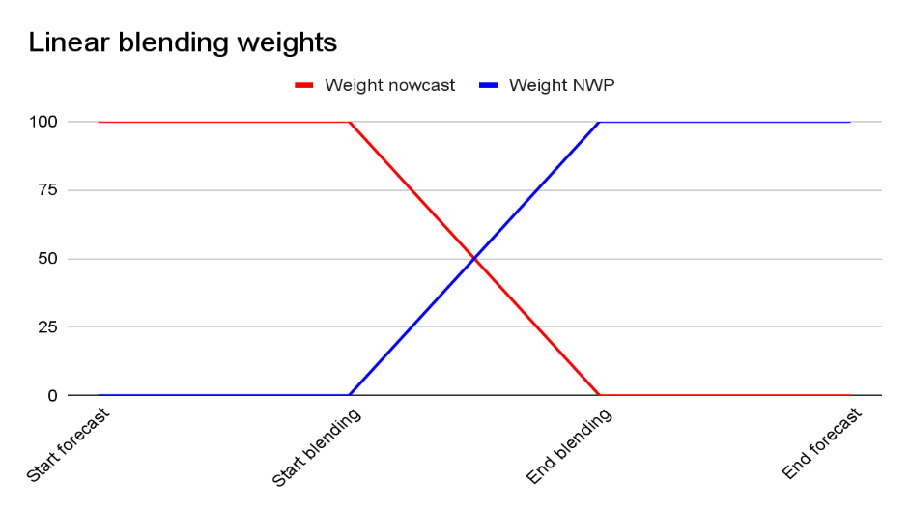
Blending with NWP: methods in pysteps
1. Linear blending
Fixed start and end point of blending procedure
Weights go linearly from 1 to 0 and 0 to 1.
2. Saliency-based blending
Similar to linear blending, but:
Preserves pixel intensities over time if they are strong enough according to their ranked salience.
3. STEPS blending (see next slide)
Hwang et al., 2015, Weather and Forecasting

Slide 12
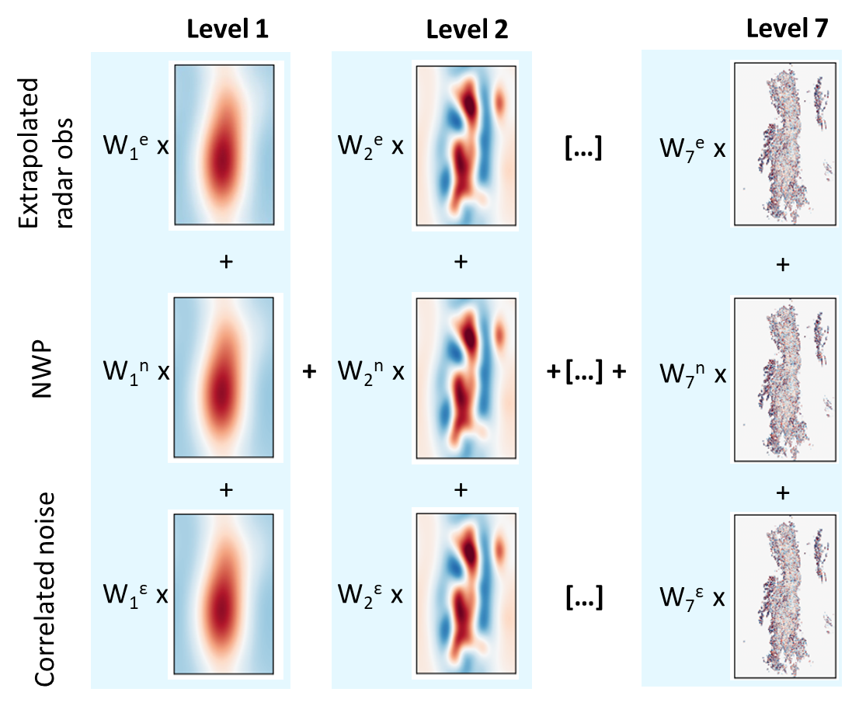
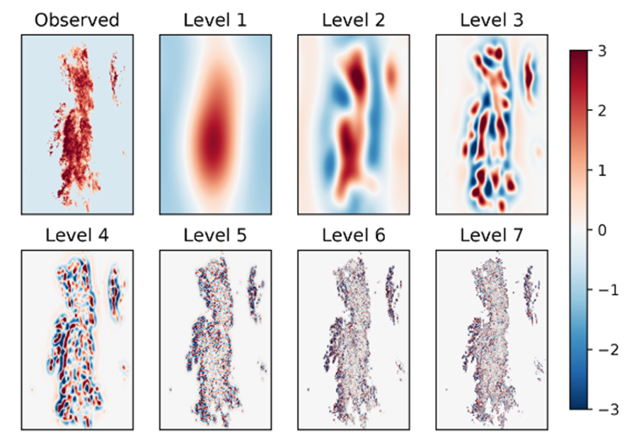
The STEPS method
See the QPN session on Monday (16:30 - 18:00) for more information about this method and its’ implementation in pysteps!
Per ensemble member:
Pulkkinen et al., 2019
Blending weights depend on initial and expected future skill

Slide 13
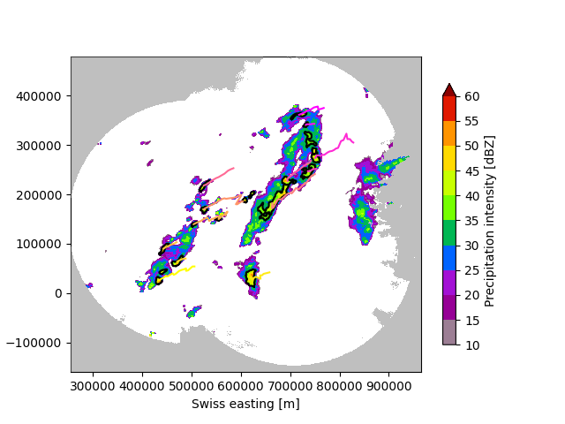
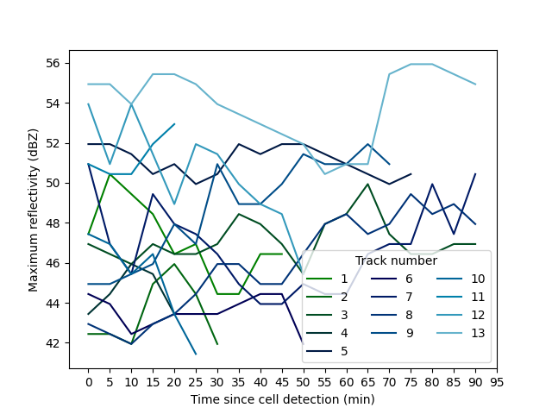
T-DaTing module: Thunderstorm
Detection and Tracking
Identify and track thunderstorm cells from radar images
Visualize cells and tracks in time
Study properties of the cell tracks
Tracking algorithm from the Swiss TRT Thunderstorms Radar Tracking algorithm
Hering et al., 2004, ERAD 2004
Feldmann et al., 2021, Weather Clim. Dynam
For how to use, see the example in the gallery

Slide 14
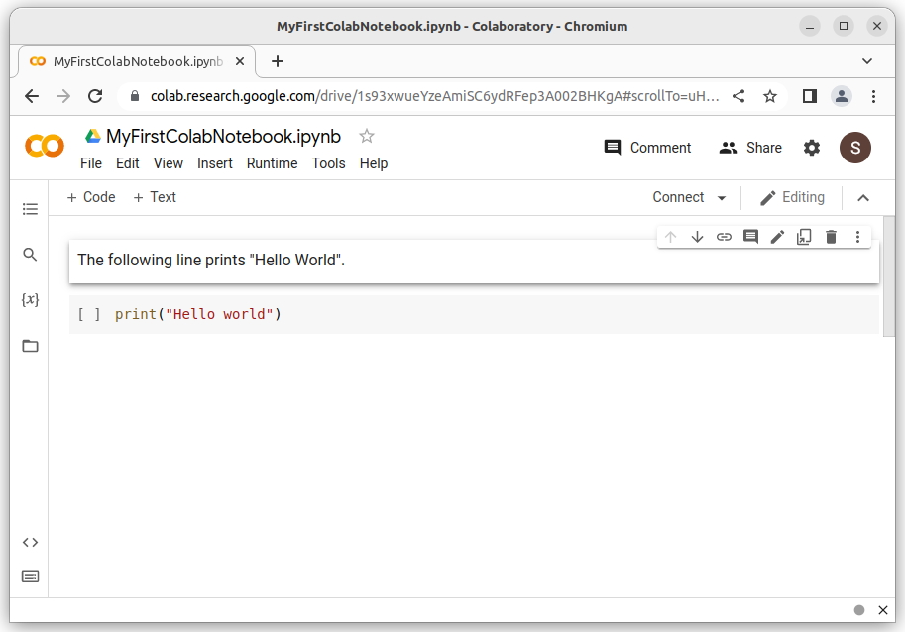
Introduction to Google Colab
https://research.google.com/colaboratory
Colab is a web-based Python environment
Free of charge to use: you only need to have a Google account
Support for different types of blocks:
Code: runnable code with output
Section: for organizing your notebook
Text: descriptions of code blocks
The default environment has:
Python 3.7 with a large number of scientific packages pre-installed
1 Intel Xeon CPU core with 2 threads
12 GB memory, 100 GB disk space + Google drive

